Slide 1


The Fantastic Four: A Cross Platform Maps App With .NET Runtime SDK
MARA STOICA
2018 Esri DEVSummit Conference | Palm Springs, CA

Slide 2


Agenda
What are Example Apps
Maps App – Demo
Maps App – Solution Architecture
Maps App – Shared Code
Contact and Resources
Questions

Slide 3

Example Apps
More than just sample code

Slide 4

Example Apps
More than just sample code
REAL world apps based on use cases collected from users
COMPLETE working apps with detailed instructions for getting started
OPEN source on GitHub (Apache 2.0 license)
Supporting documentation (code, data creation, app workflows, customization)
SDK | Apps Released | Apps In Progress
Android | 4 | 1
.NET | 3 | 1
iOS | 2 | 1
JavaScript | 1 | 0
QT/QML | 0 | 1

Slide 5

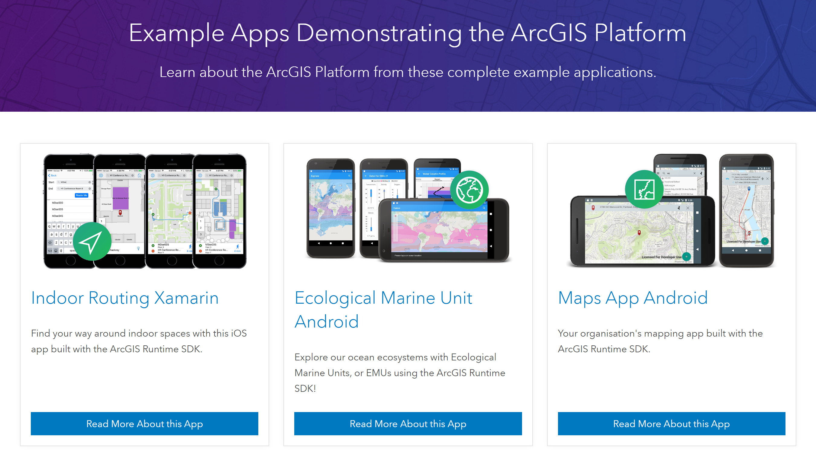
Example Apps
More than just sample code
https://developers.arcgis.com/example-apps/

Slide 6

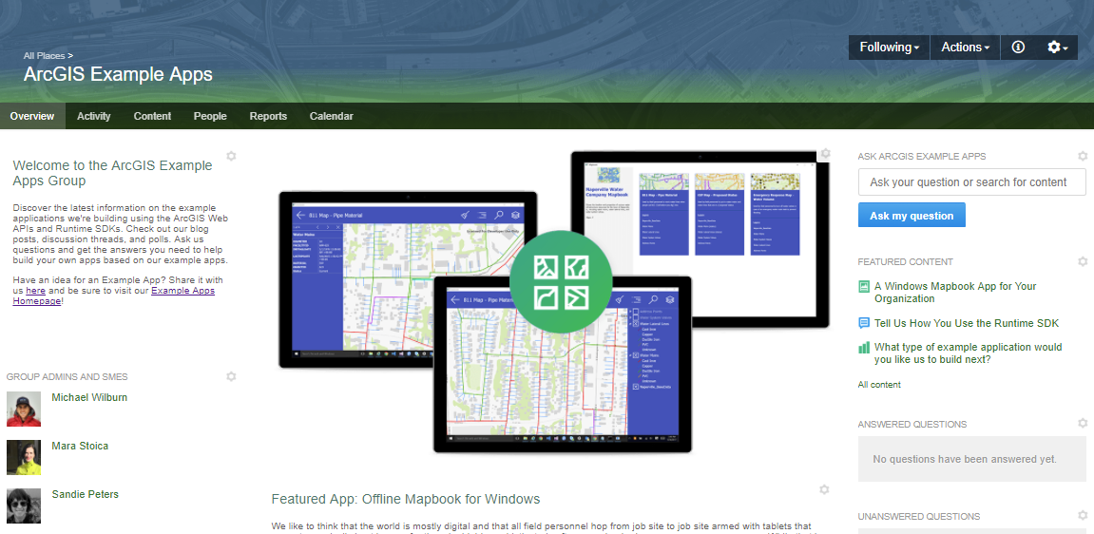
Example Apps
More than just sample code
https://community.esri.com/groups/arcgis-example-apps

Slide 7
Maps App

Slide 8

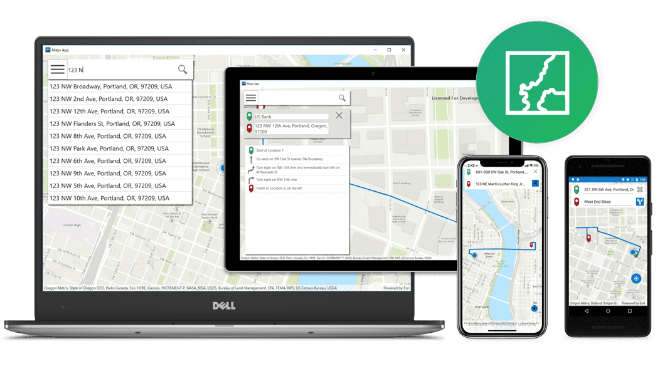
Maps App Demo

Slide 9






Maps App – Solution Architecture

Slide 10
Let’s look at some code

Slide 11

Contact & Resources
Repo: https://github.com/Esri/maps-app-dotnet
Example Apps Site: https://developers.arcgis.com/example-apps/
GeoNet Community: https://community.esri.com/groups/arcgis-example-apps
Mara Stoica
mstoica@esri.com
@codergrl

Slide 12



